Slide 1
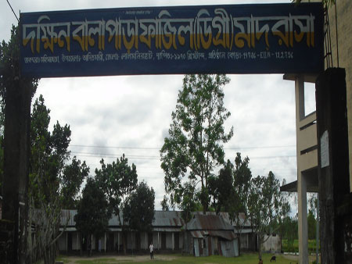
welcome

Slide 2
Identity
MD. ASHRAFUL ALAM
DAKKHIN BALAPARA FAZIL MADRASHA
ASISTANT Teacher (ICT)
E-Mail- amashrafulict38@gmail.com
Mobile n0- 01710141329,01751466764
Moshkhocha, Aditmari.Lalmonirhat
Subject: English 1st paper.
Class: Nine
Time: 50 mins.
Date: 07-09-14
Notes:
Lalmonirhat

Slide 3
Look at the picture and talk about it.
1.What’s the picture about?
2. Where do you think it is?
3.Why was it built?

Slide 4
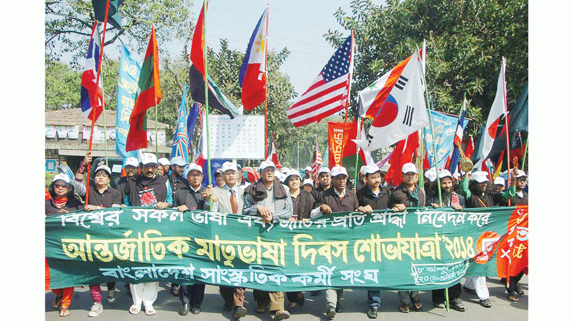
International Mother Language Day-1
Unit-3, Lesson-3. Page-37.

Slide 5
By the end of the lesson, students will be able to ---
discuss about the picture.
infer meanings of some words from the context.
read the passage and complete the chart.
match the words with their meanings.
ask and answer the questions.
write briefly about observing 21 February in their school.

Slide 6
vocubulary

Slide 7
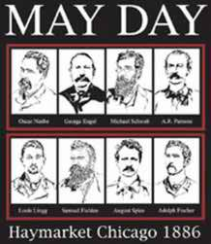
Memorable
Rememberable

Slide 8
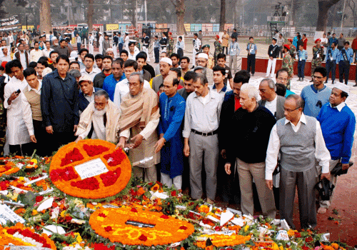
Tribute
Showing respect or love

Slide 9
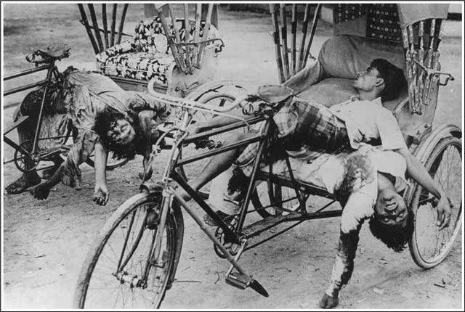
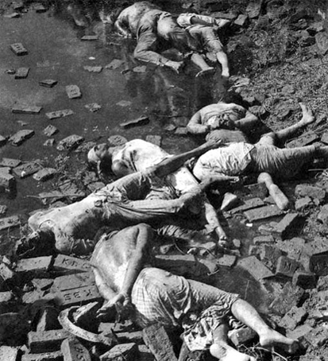
Martyrs
Those who sacrifice their lives for the country/nation.

Slide 10
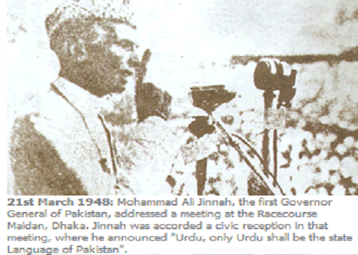
Declare
To announce something clearly,firmly,publicly or officially.

Slide 11
Now read the passage loudly and find more new words.

Slide 12
Now read the passage silently and complete the chart.
Time | What hapened
1947
1948
1952

Slide 13
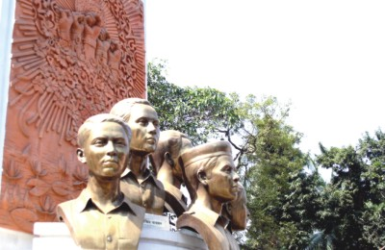
Look at the pictures and answer these questions bellow:
Why do we observe 21 February as the International Mother Language Day?

Slide 14
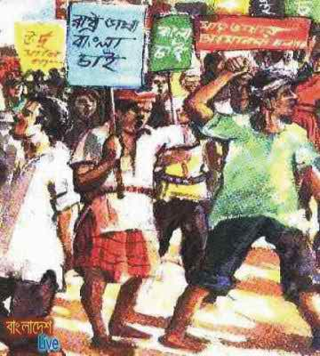
What happened when Urdu was declared as the only official language of Pakistan?

Slide 15
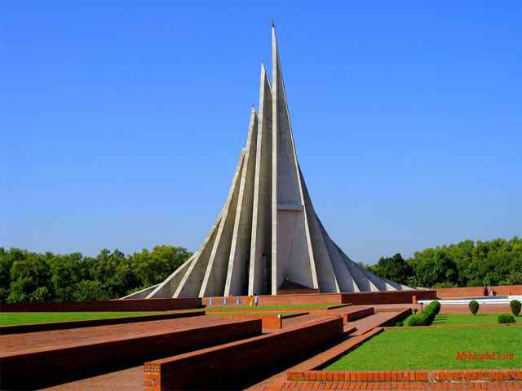
“The seed of independence was sown in 21 February 1952”. Do you agree with the comment? Why?

Slide 16
Match the words with their meaning
Words | Meanings
Tribute | * to have a particular effect
climax | * to refuse to obey
outlaw | * to give in
defy | * the ability to keep increasing or developing
provoke | * an act to show respect or admiration
relent | * the most exciting point in time
momentum | * to ban

Slide 17
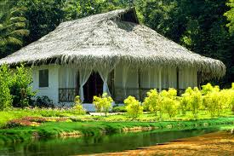
Home Task
Write briefly how you observed this year’s 21st February at your school.

Slide 18
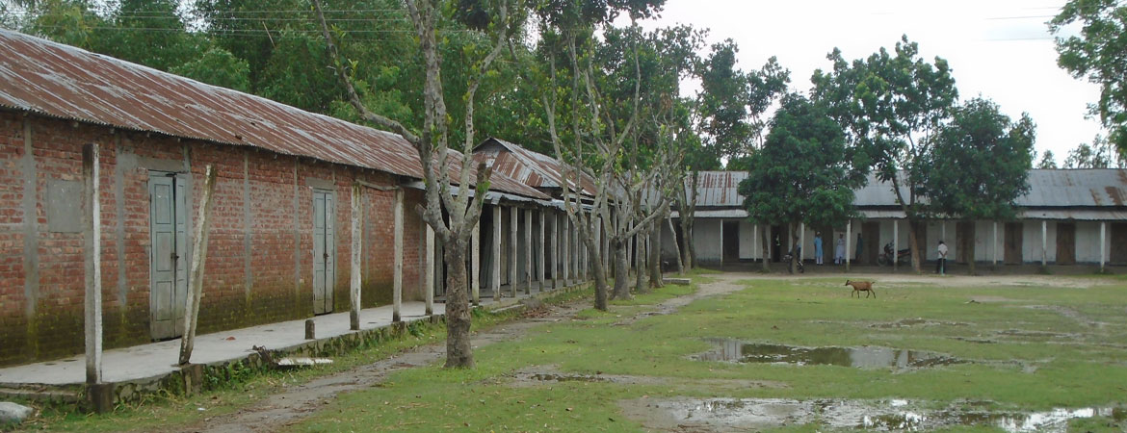
Thank you

